Slide 1
Computer Vision: Portfolio 2
A Portfolio Presentation of Assignments in Explainable and Edge Al
Prahas Hegde, Rohan Sanjay Patil, Vidya Padmanabha
Lecturer: Prof. Dr. Dominik Seuß

Slide 2

Tackling Two Critical Frontiers in Applied Al
Part I: Explainable Al in Medicine
Part II: Edge Al for Industry 4.0
The Challenge of Trust
How can we make life-or-death decisions from a medical Al transparent and trustworthy for clinicians?
The Challenge of Speed
How do we make Al fast, reliable, and small enough to perform quality control on a high-speed factory floor?

Slide 3
ASSIGNMENT 1
Explainable AI for Medical Imaging - Interpreting Chest X Ray Pneumonia Predictions

Slide 4
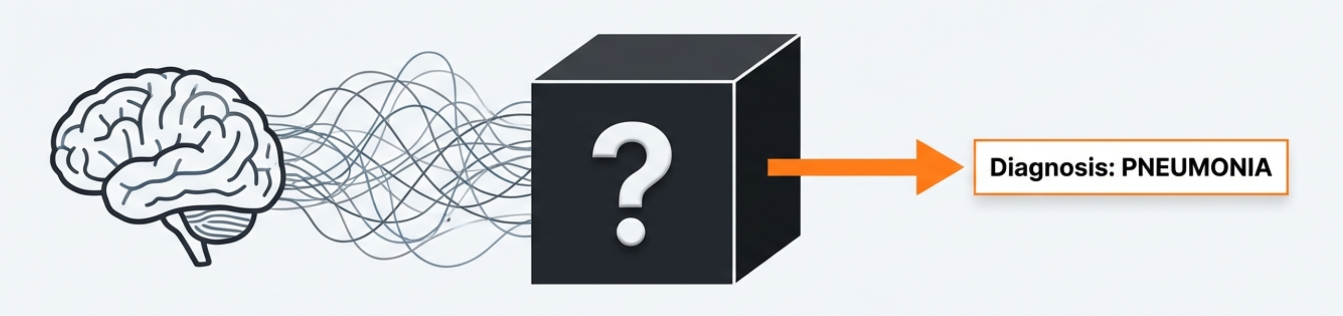



The ‘Black Box’ in Medical Al is a Critical Barrier to Trust
High Performance: Deep learning models can diagnose diseases with high accuracy.
Lack of Transparency: Their decision-making process is often opaque, making it difficult to understand *why* a prediction was made.
The Trust Gap: This opacity creates a barrier to adoption where accountability and understanding are essential.

Slide 5
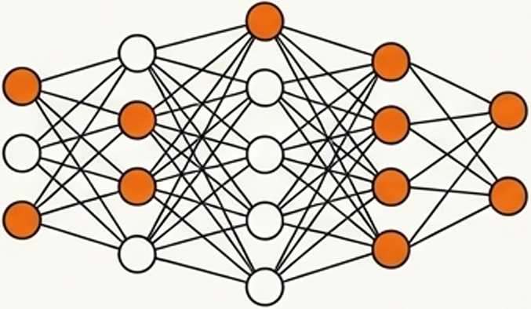

Our Objective: To Build and Interpret a Pneumonia Classifier
To design an end-to-end explainability pipeline that can not only detect pneumonia but also provide clear, visual justifications for its predictions.
1. Prediction
2. Explanation
Fine-tune a high-performance ResNet50 model to classify chest X-rays as ‘Normal’ or ‘Pneumonia’.
Integrate and compare two distinct XAI methods to unlock the model's decision making process: Grad-CAM and LIME.

Slide 6
Our ResNet50 Model Achieves 87% Diagnostic Accuracy
Confusion Matrix - Test Set
172 | 62
22 | 368
Overall Test Accuracy: 87%
Precision (Pneumonia): 86%
Recall (Pneumonia): 94%
The model demonstrates strong performance, particularly in correctly identifying pneumonia cases (high recall), making its decisions worthy of explanation.
NORMAL
True Label
PNEUMONIA
NORMAL PNEUMONIA
Predicted Label

Slide 7
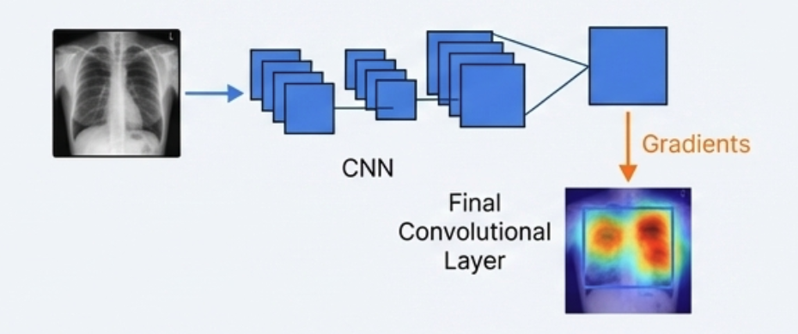
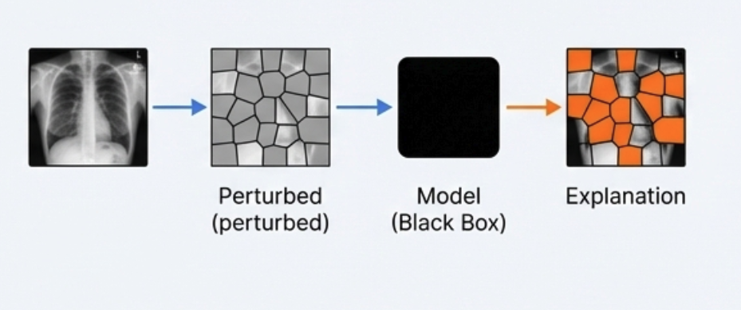
Two Methods Provide Different Windows into the Model’s Logic
Grad-CAM
LIME
"What did the model see?"
"Why did it make this choice?"
X-ray
Concept: Uses the model’s internal gradients to create a heatmap, highlighting the pixels most important for a decision.
Analogy: Like a “neural attention map.”
Type: White-box (requires access to model internals).
Concept: Treats the model as a black box. It perturbs the image and learns a simple, local model to explain which regions influenced the prediction.
Analogy: Like asking “what if this part was missing?"
Type: Black-box (model-agnostic).

Slide 8
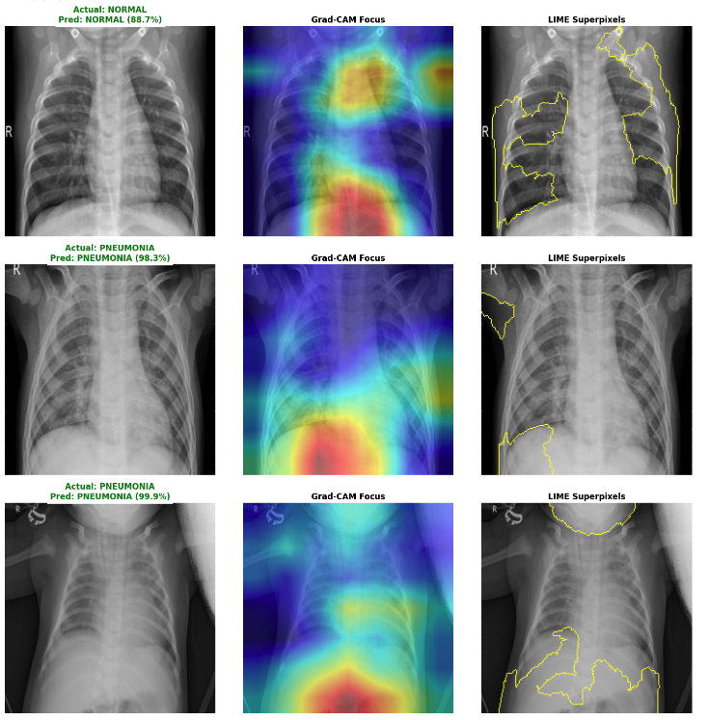
Visual Explanations Reveal Both Agreement and Divergence

Slide 9
Grad-CAM Excels in Consistency, While LIME Offers Simpler Interpretation
FEATURE | GRAD-CAM | LIME
Resolution | Pixel-level (High) | Superpixel-level (Medium)
Interpretation | Shows Gradient Importance | Shows Feature Importance
Speed | Fast | Slower
Consistency | 9/10 | 5/10
Agreement : Both methods focus on the correct lung field and areas with visible opacity when it is classified as Pneumonia.
Key Differences: Grad-CAM Provides precise, reproducible heat maps. LIME provides intuitive but less stable region-based explanations.

Slide 10
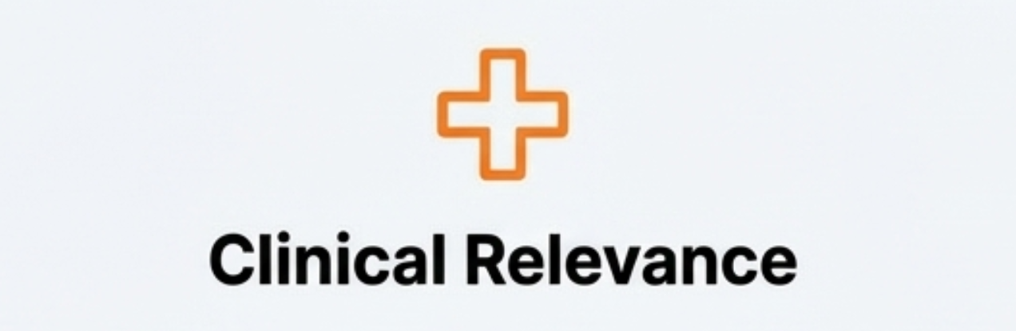
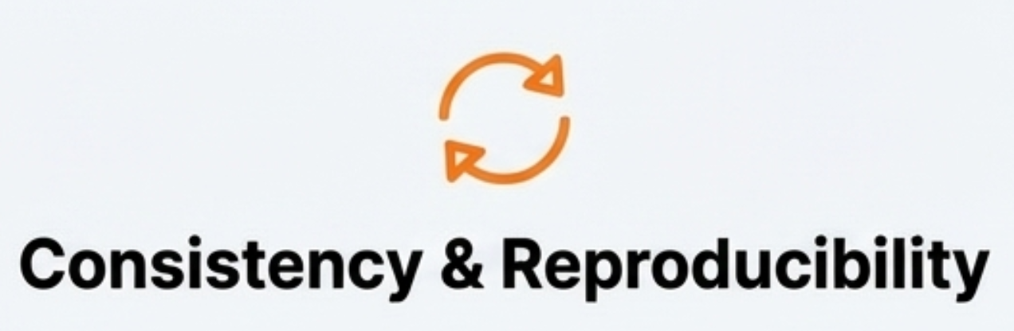
We Developed Two Criteria to Evaluate Explanation Quality
What makes an explanation 'good' in a clinical context?
Definition: Does the explanation highlight anatomically and pathologically meaningful regions?
Assesses: Focus on lung parenchyma, avoidance of artifacts (e.g., labels, bones), and correlation with visible opacities.
Definition: How stable and reliable is the explanation? Does it produce the same result every time for the same input?
Assesses: The deterministic vs. stochastic nature of the method Critical for reliable comparison and trust.

Slide 11
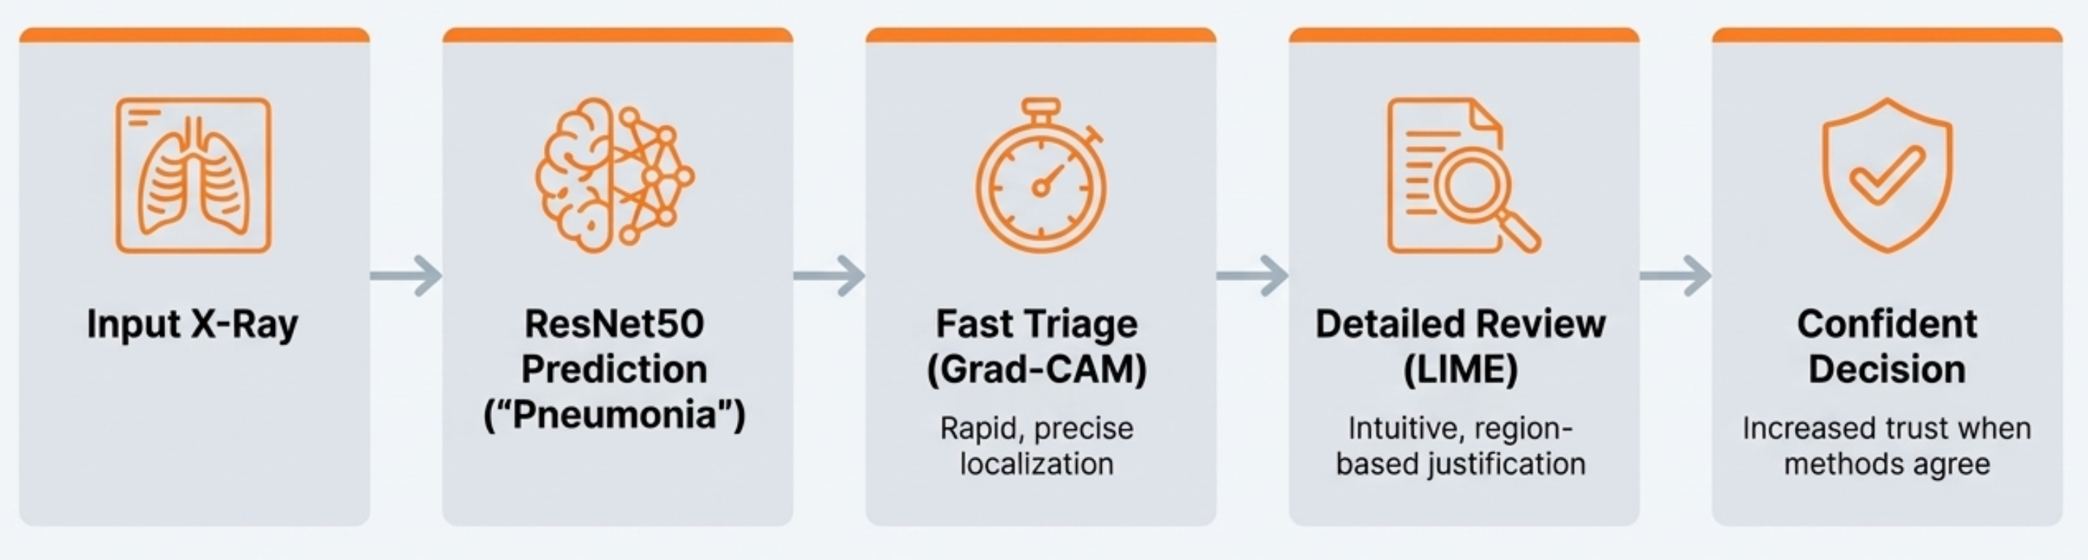
Recommendation: A Combined Approach to Build Clinical Trust
For a robust and trustworthy diagnostic system, we recommend a dual-analysis approach.
By combining the speed and precision of Grad-CAM with the intuitive clarity of LIME, we can create more transparent, reliable, and ultimately more trustworthy medical Al.

Slide 12
ASSIGNMENT 2
Edge AI for Industry 4.0 - Optimizing Models for On Device Inference

Slide 13
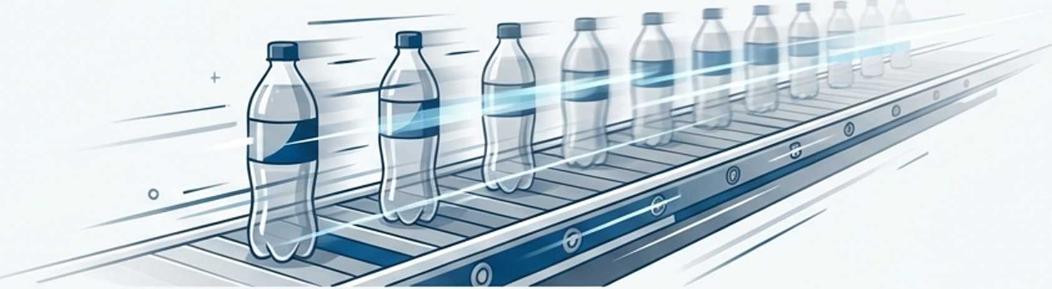
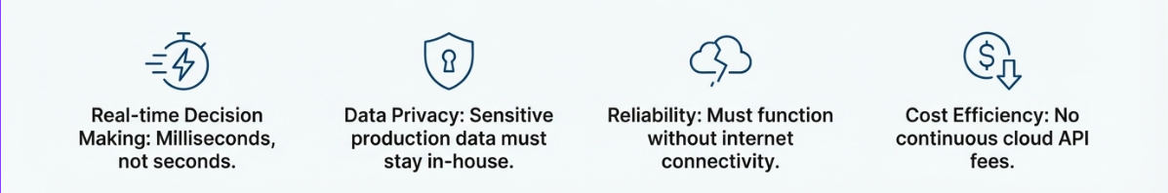
Use Case Scenario: Automated Beverage Bottle Quality Inspection
A beverage bottling facility must inspect every bottle for multiple defects before it leaves the factory. 500 bottles/minute means only 120ms per bottle.

Slide 14
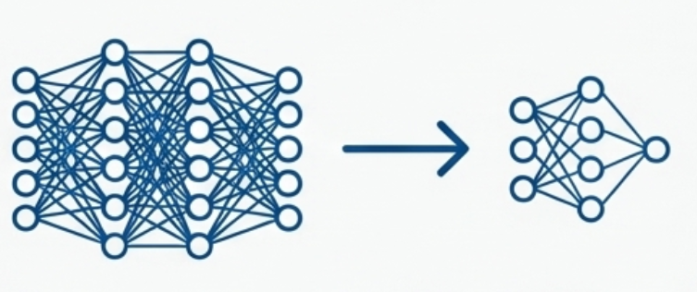
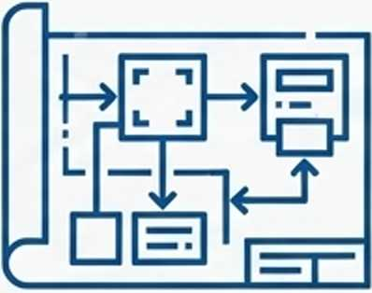
Our Objective: Optimize a Model and Design an Edge Al System
Practical Model Optimization
Edge Al System Design
Compress a pre-trained ResNet18 model by a target of 50%, removing parameters while maintaining (or improving) accuracy for deployment on a resource-constrained device.
Sketch a complete system architecture, demonstrating how Al at the edge outperforms a cloud solution in an Industry 4.0 scenario.

Slide 15
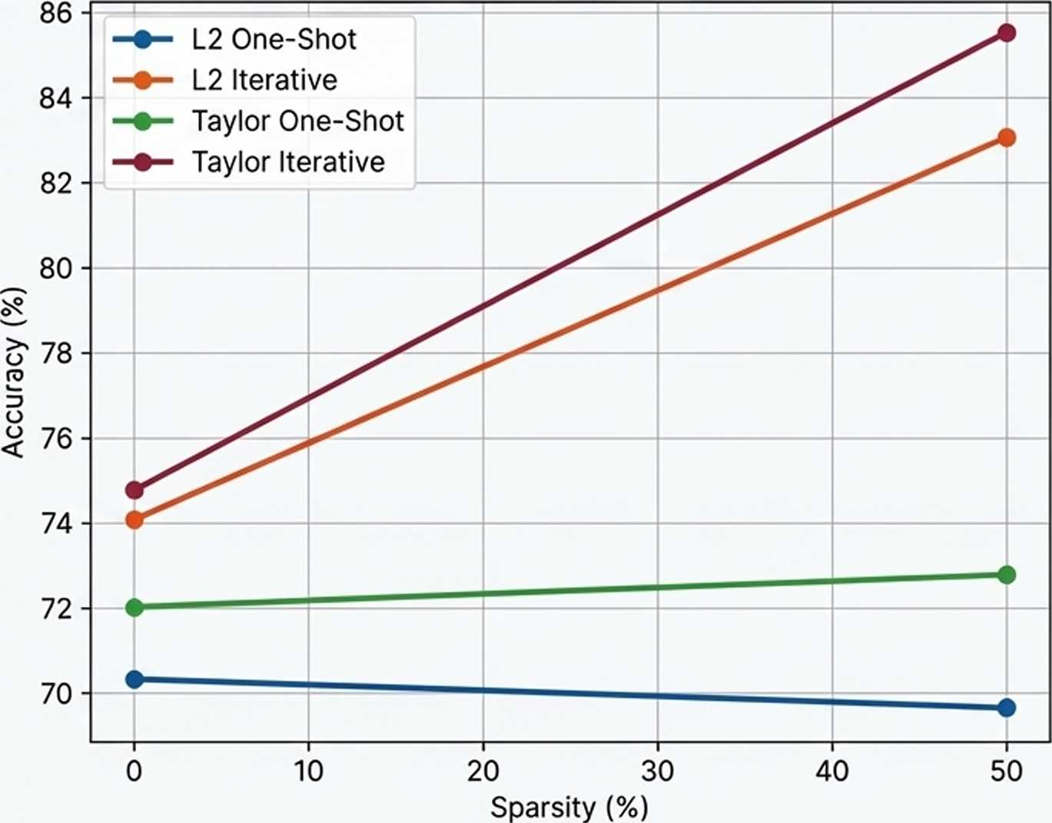

Iterative Pruning Delivered Higher Accuracy with a Smaller Model
Accuracy vs. Sparsity Trade-off
Key Insights
• Iterative pruning (Taylor & L2) significantly outperforms One-Shot pruning in recovering and improving accuracy.
• The pruned models achieved higher accuracy than the baselines. This suggests the original model was over-parameterized, and pruning acted as a form of regularization.
Method: Taylor Iterative
Baseline Accuracy: 74.76%
Pruned Accuracy: 85.55%(+10.79%)
Sparsity Achieved: 49.52%
Size Reduction: from 39.62 MB to 21.71 MB

Slide 16
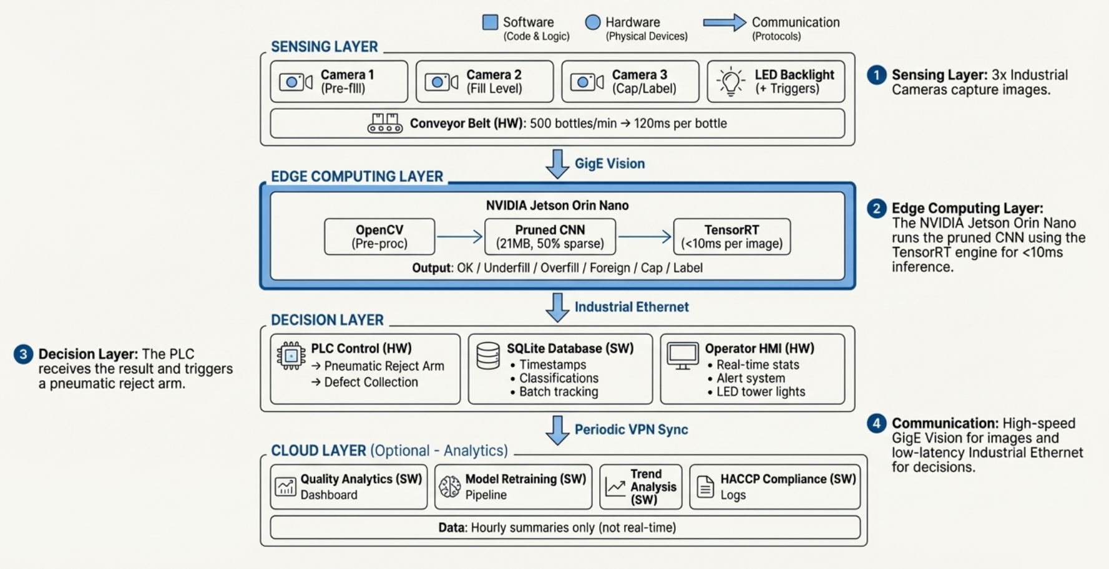
A Complete Edge Al System Architecture

Slide 17


How Optimization Translates to Factory Floor Benefits
Structured Pruning (The Throughput Booster)
• Drastically reduces calculation time, ensuring the Al can process 500+ frames per minute and never becomes a production bottleneck.
• Lowers heat generation, preventing the fanless, sealed device from overheating and causing a line shutdown.
Quantization (The ‘Reaction Time’ Accelerator)
• Simplifies calculations, guaranteeing the decision signal reaches the reject arm in under 10 milliseconds, ensuring the bad bottle is removed before it moves past.
• Reduces electrical load and long-term operational costs.

Slide 18

The Critical Balance: Avoiding the Risks
of Over-Compression
Increased False Negatives
If compressed too aggressively, the model may fail to detect subtle defects (e.g., slight fill level deviations).
Consequence: Defective products reach customers, leading to product recalls and brand reputation damage.
Loss of Robustness & Generalization
The model may become brittle and fail when faced with normal production variations like changes in lighting or new bottle designs.
Consequence: Sudden performance drops require costly re-tuning, undermining the benefits of Edge Al.

Slide 19
THANK YOU

